Slide 1
Determine Dielectric Constant in 1D Microwave Cavity
Yutong Zhao
Jan 15th ,2018

Slide 2
Target
Determine the complex dielectric constant of different mediums:
NaCl, NH₄NO₃, KNO₃, NaNO₃, KClO₃ (humidity 0-10%)
Mixture of two above (humidity 0-10%)
Al powder
Water
Icing sugar (humidity 0-10%)
Gasoline and diesel
According to DRDC’s contract section 6.5

Slide 3
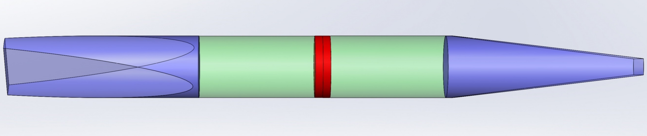
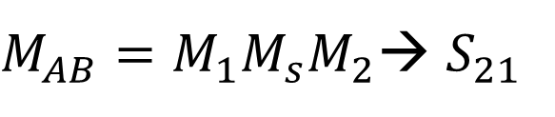
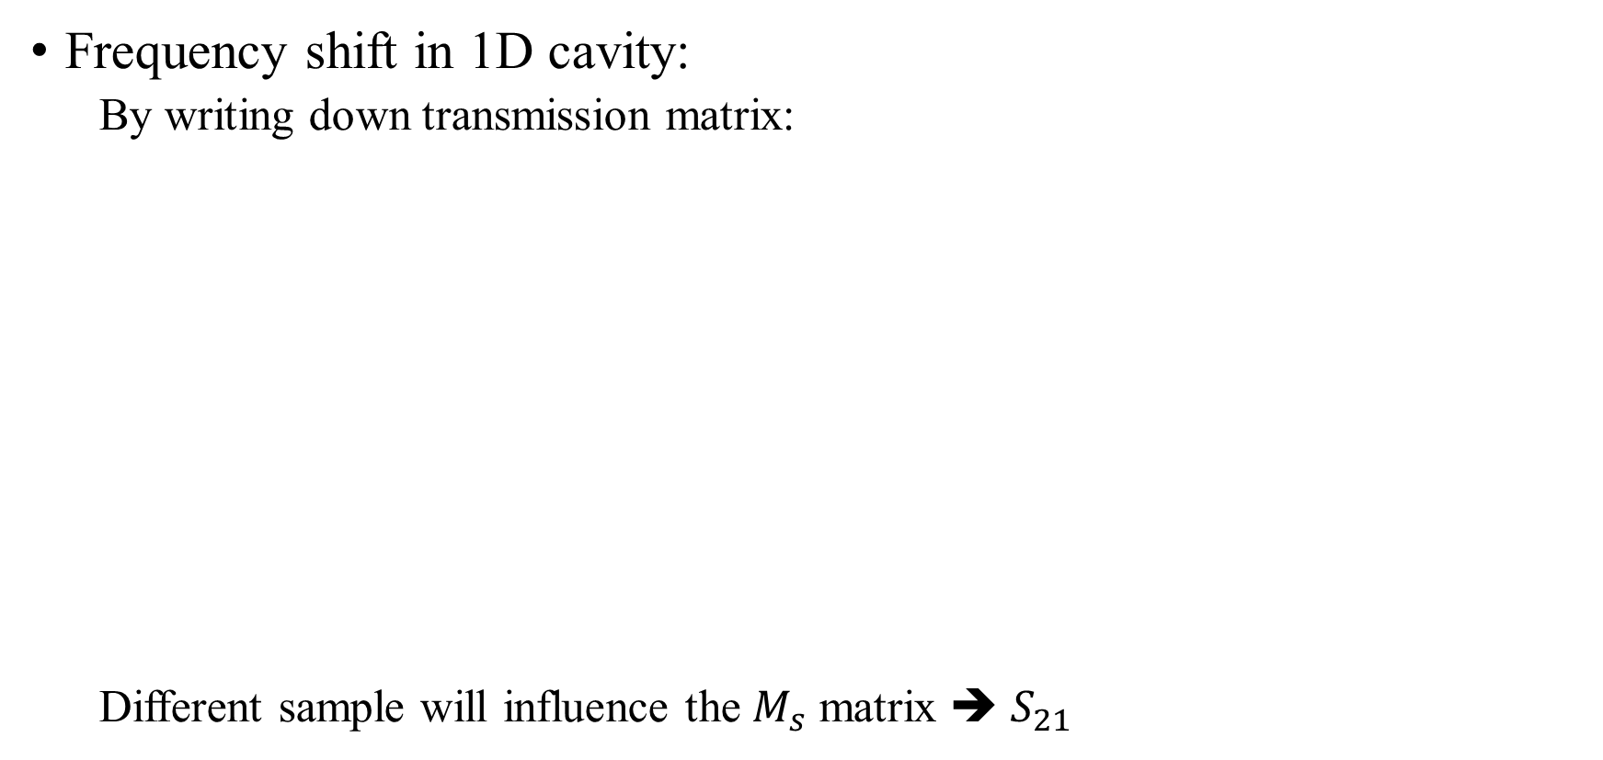
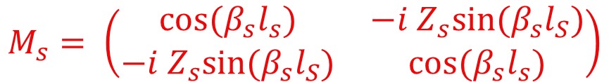
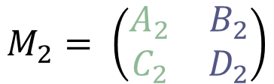
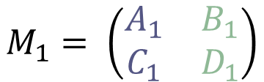
Resonance method
Frequency shift in 1D cavity:
By writing down transmission matrix:
Different sample will influence the $M_{s}$ matrix ➔ $S_{21}$
$$M_{1}= \left(\begin{matrix}A_{1} & B_{1} \\ C_{1} & D_{1}\end{matrix}\right)$$
$$M_{s}= \left(\begin{matrix}cos⁡(β_{s}l_{s}) & −i Z_{s}sin⁡(β_{s}l_{S}) \\ −i Z_{s}sin⁡(β_{s}l_{S}) & \cos{(β_{s}l_{s})}\end{matrix}\right)$$
$$M_{2}= \left(\begin{matrix}A_{2} & B_{2} \\ C_{2} & D_{2}\end{matrix}\right)$$
$M_{AB}=M_{1}M_{s}M_{2}$→ $S_{21}$

Slide 4
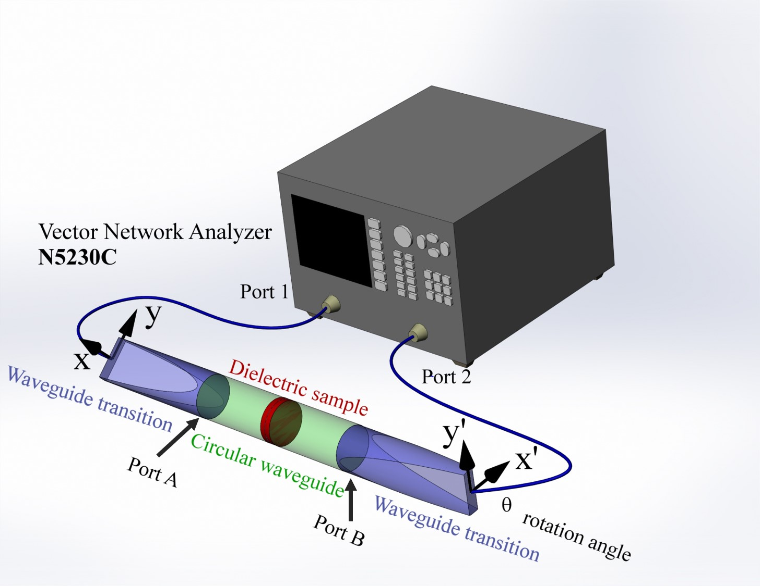
Experiment setup

Slide 5
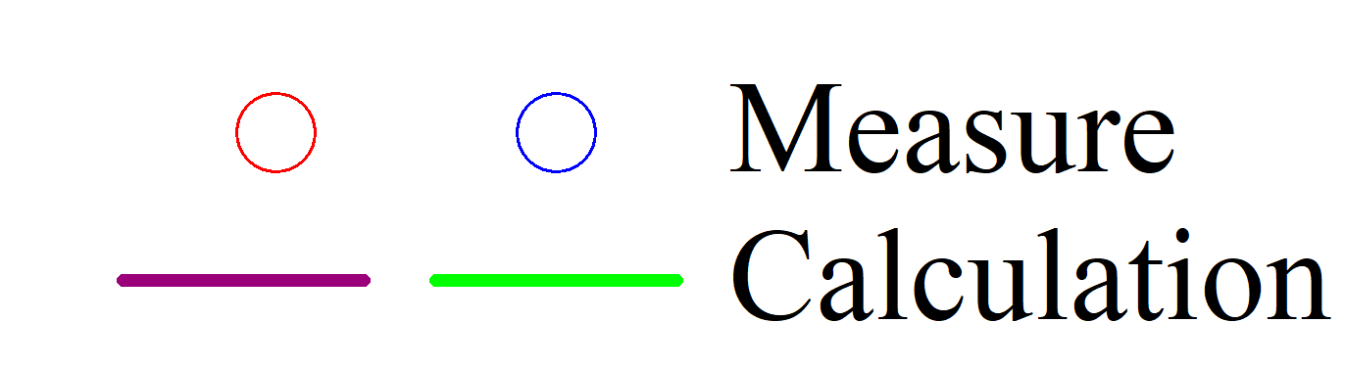
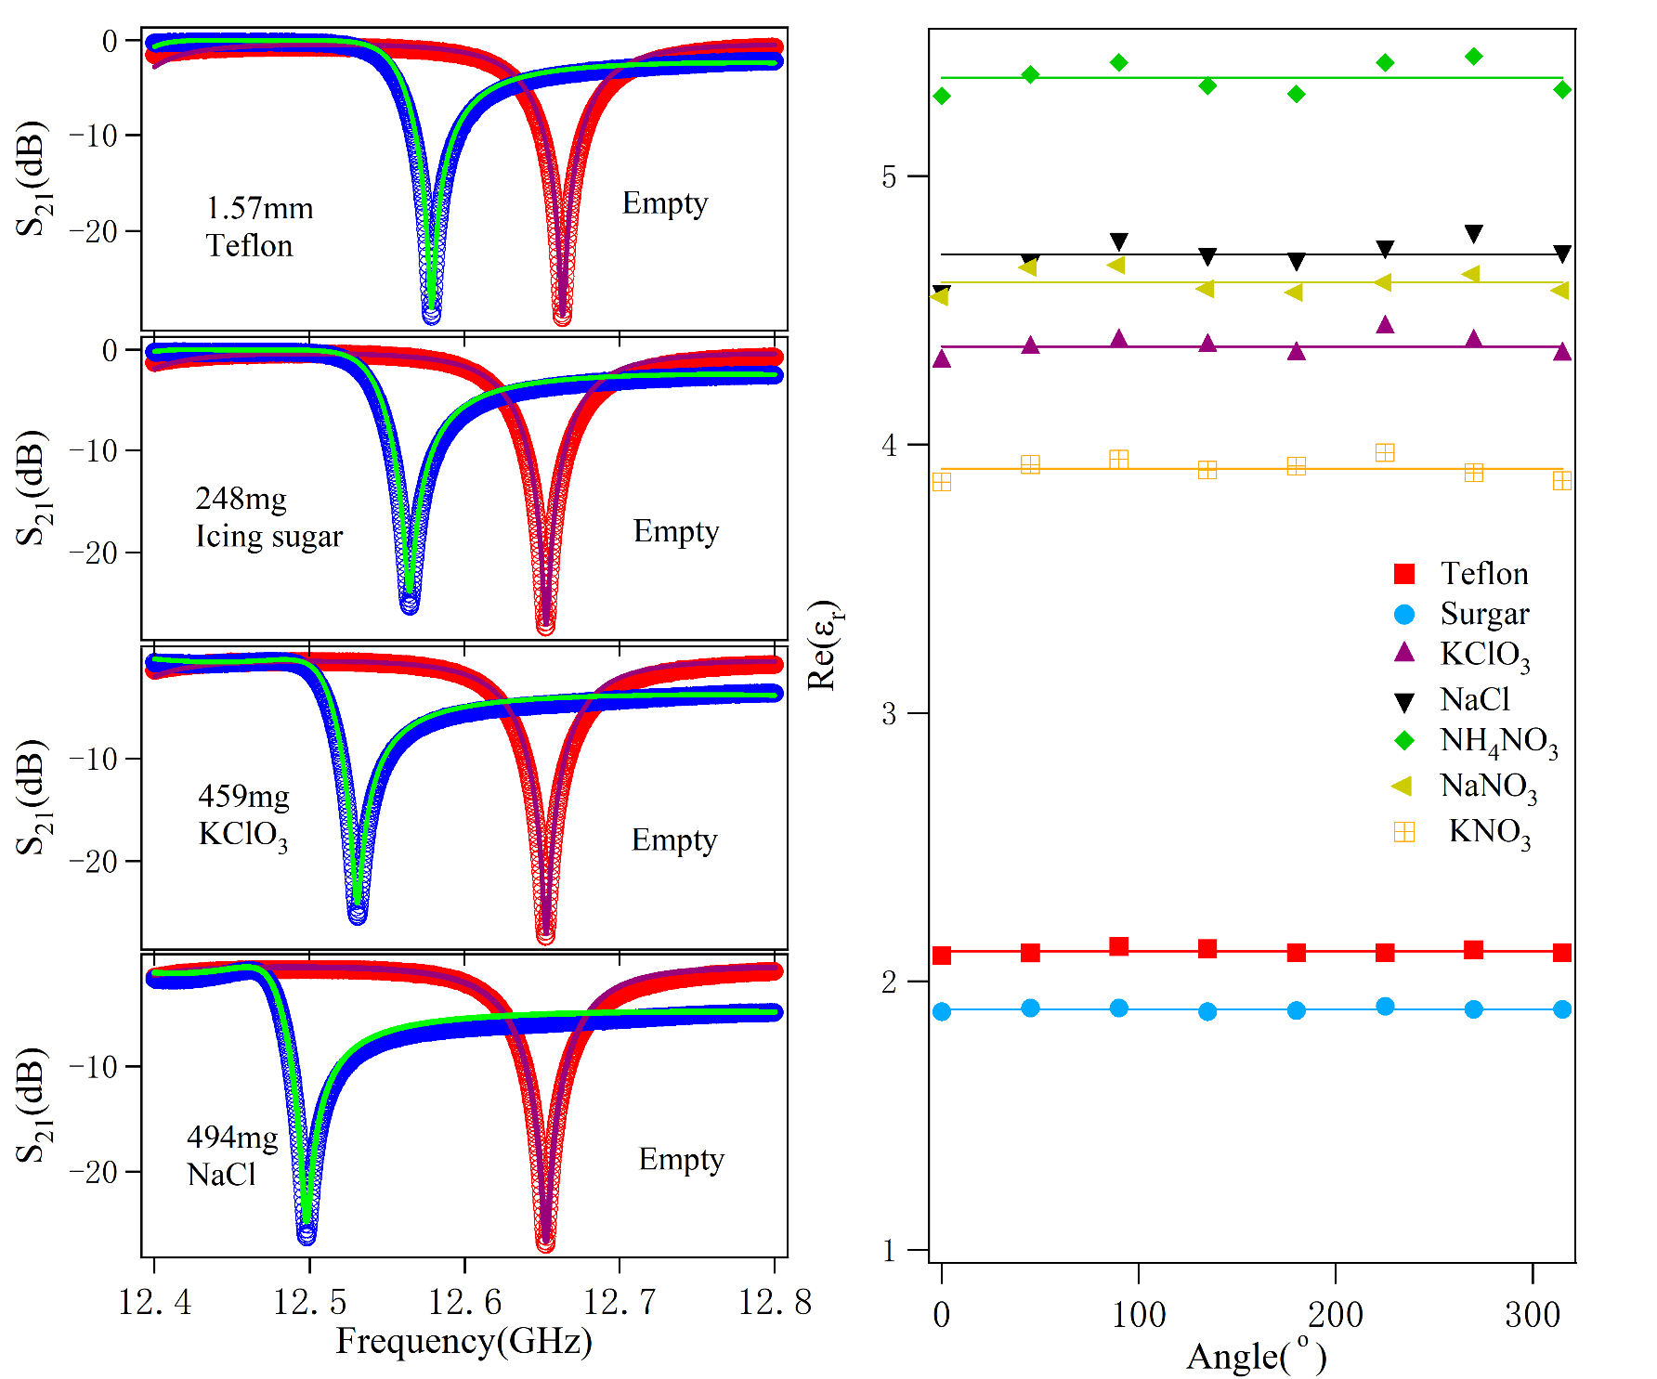
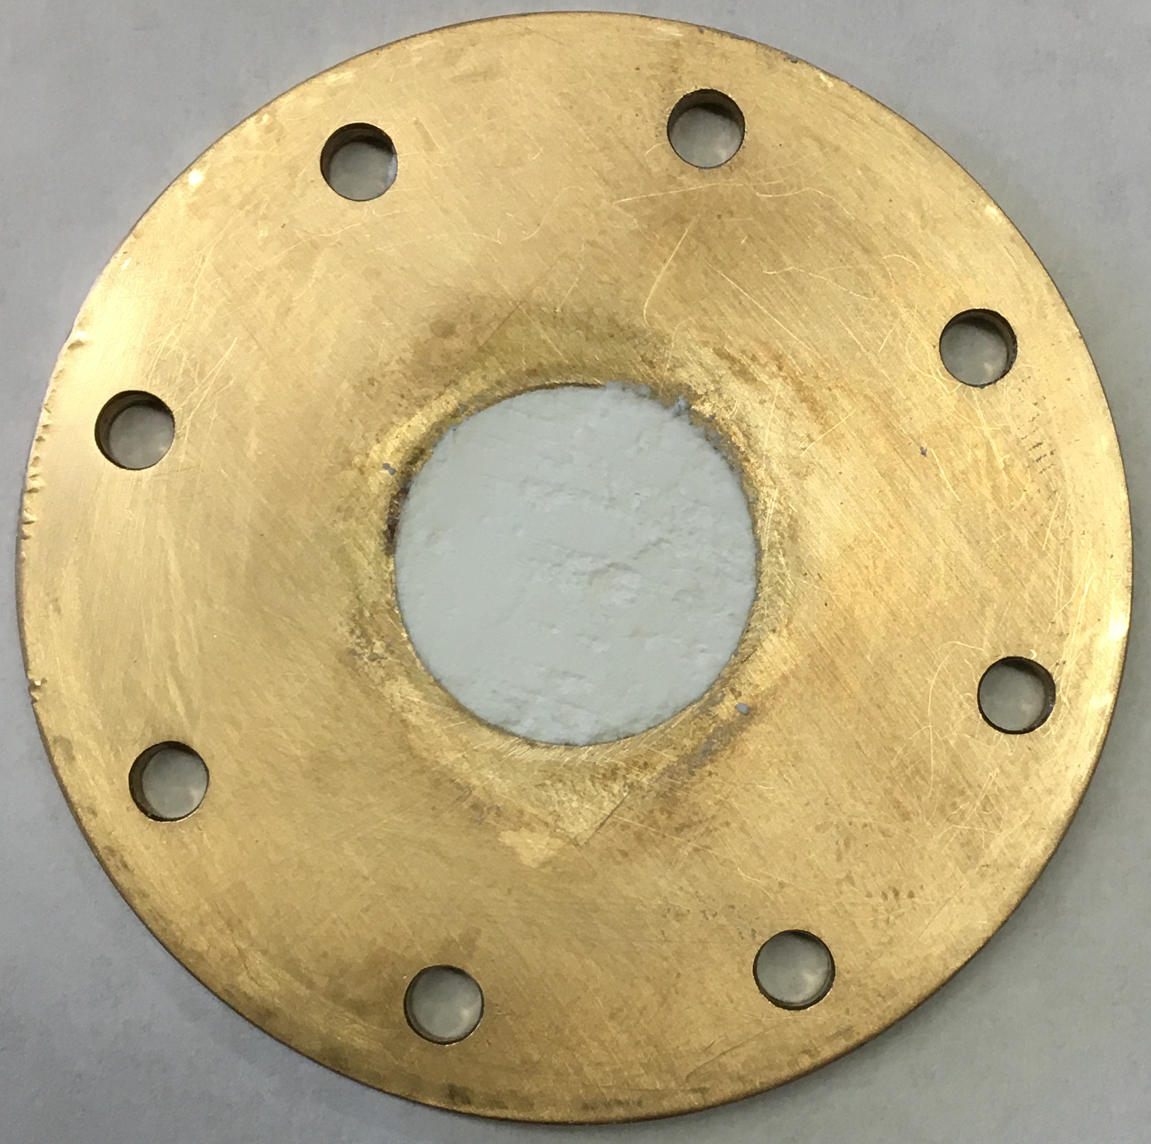
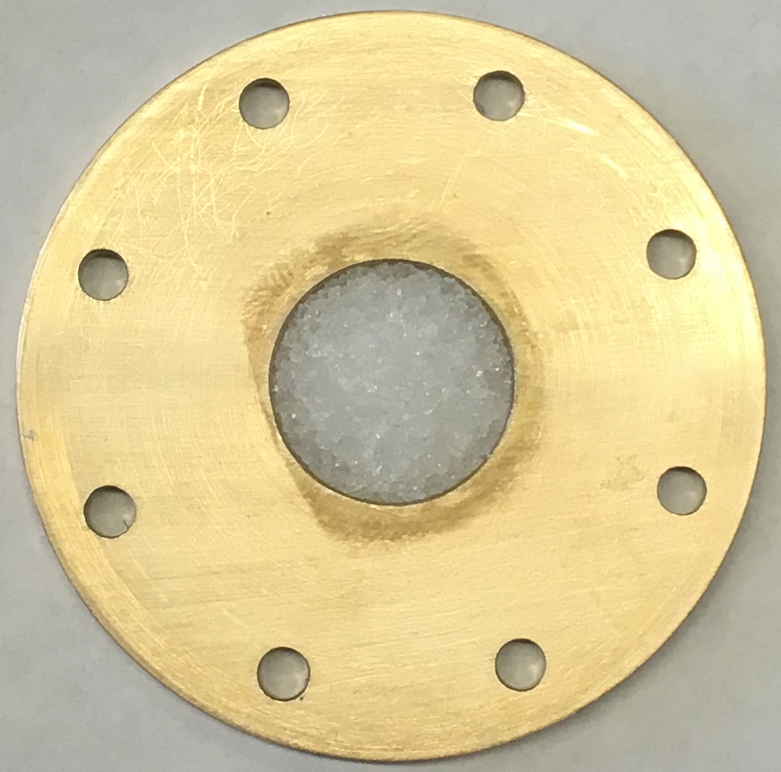
Pure materials
1.57mm
Teflon
248mg
icing sugar
Icing sugar sample
459mg
KClO₃
494mg
NaCl
NaNO₃ sample

Slide 6
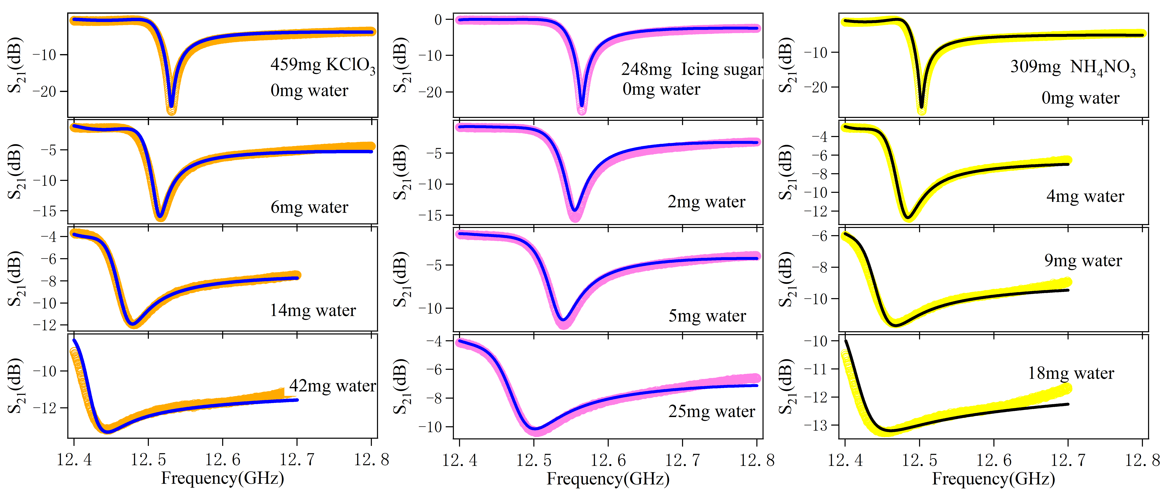
Spectra vs. humidity
459mg KClO₃
248mg icing sugar
309mg NH₄NO₃

Slide 7
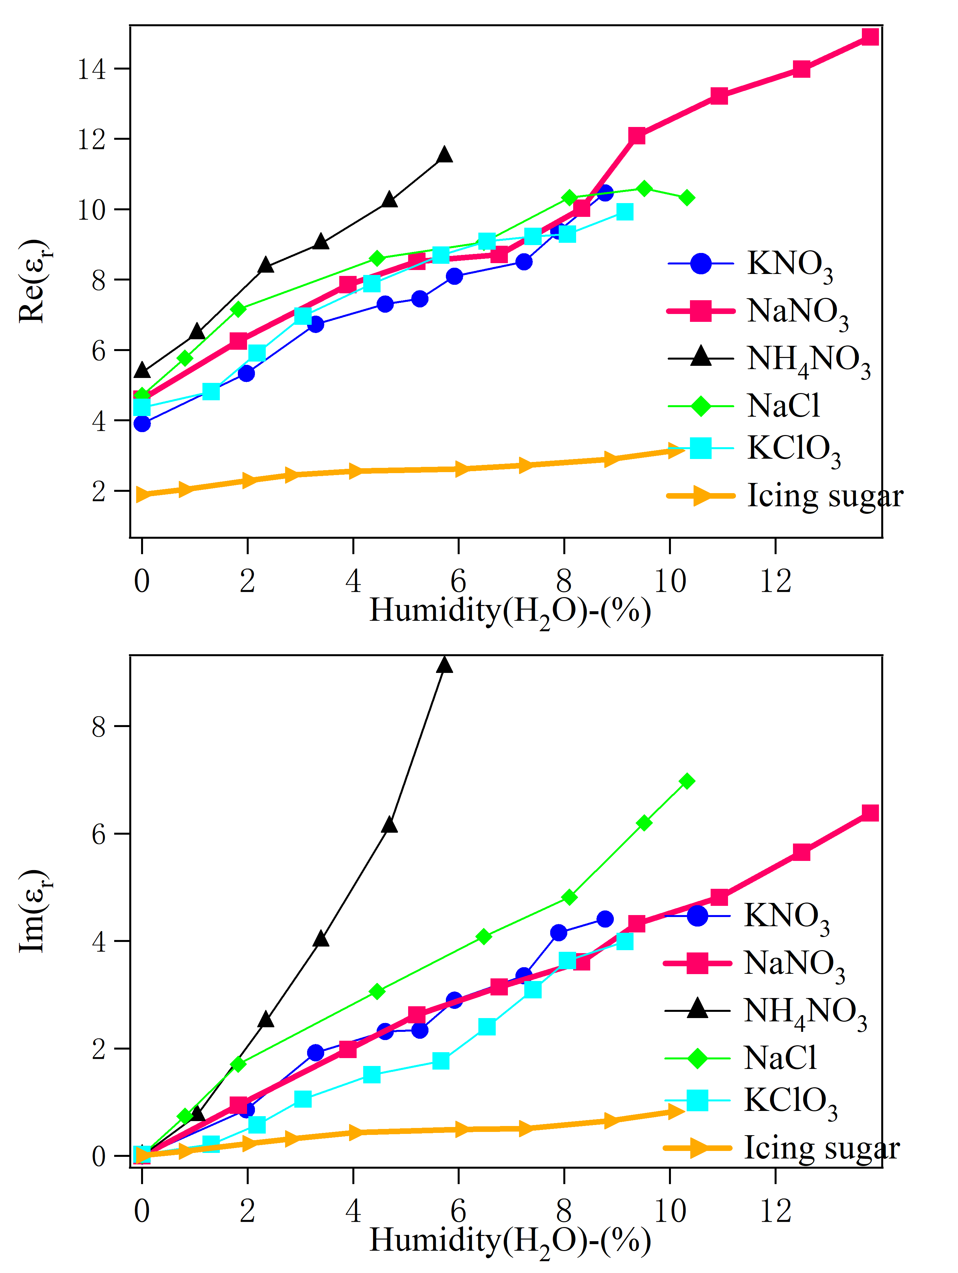
complex ε_{r} vs. humidity
Real part
Imaginary part

Slide 8
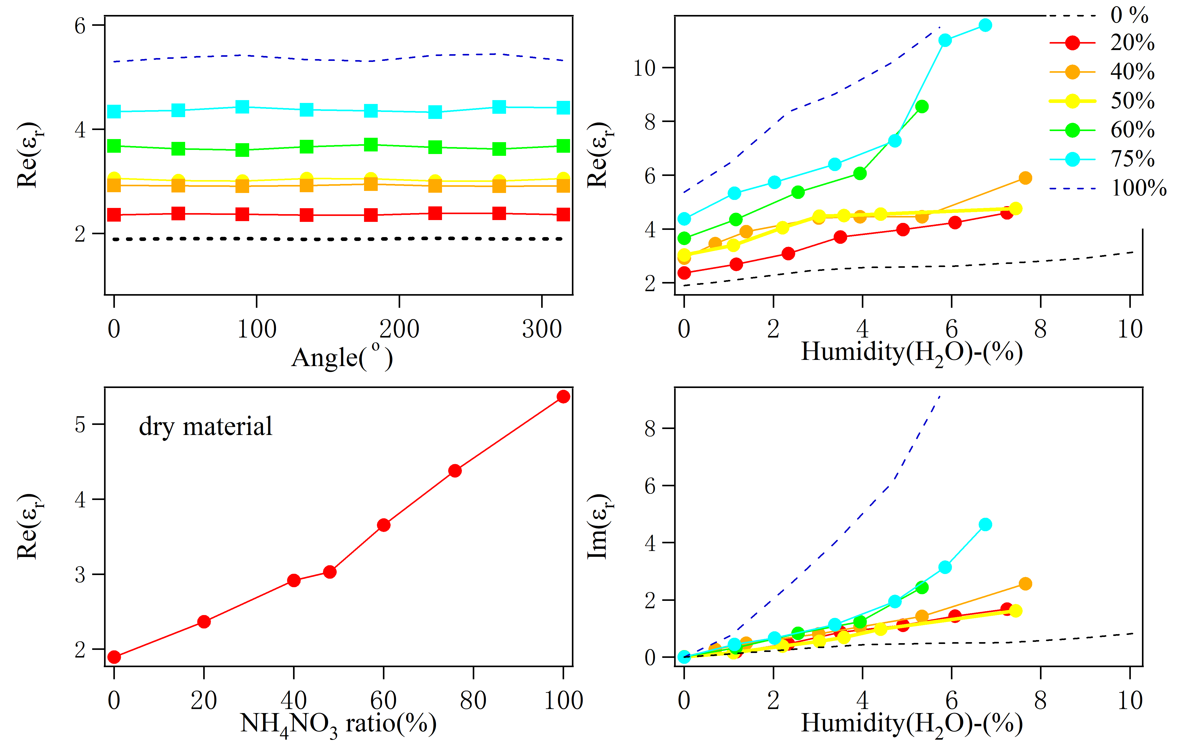
Mixture: NH₄NO₃ in sugar(dry)

Slide 9
Progress (~ 80%)
Material | Data collection | Data analysis
NaCl | √ | √
NH₄NO₃ | √ | √
KNO₃ | √ | √
NaNO₃ | √ | √
KClO₃ | √ | √
Mixture: icing sugar & NH₄NO₃ | √ | √
Mixture: KClO₃ & NH₄NO₃ | In progress(40%) | ---
Icing sugar | √ | √
Al powder | √ | √
Gasoline | √ | In progress
Diesel | √ | In progress
water | √ | In progress

Slide 10
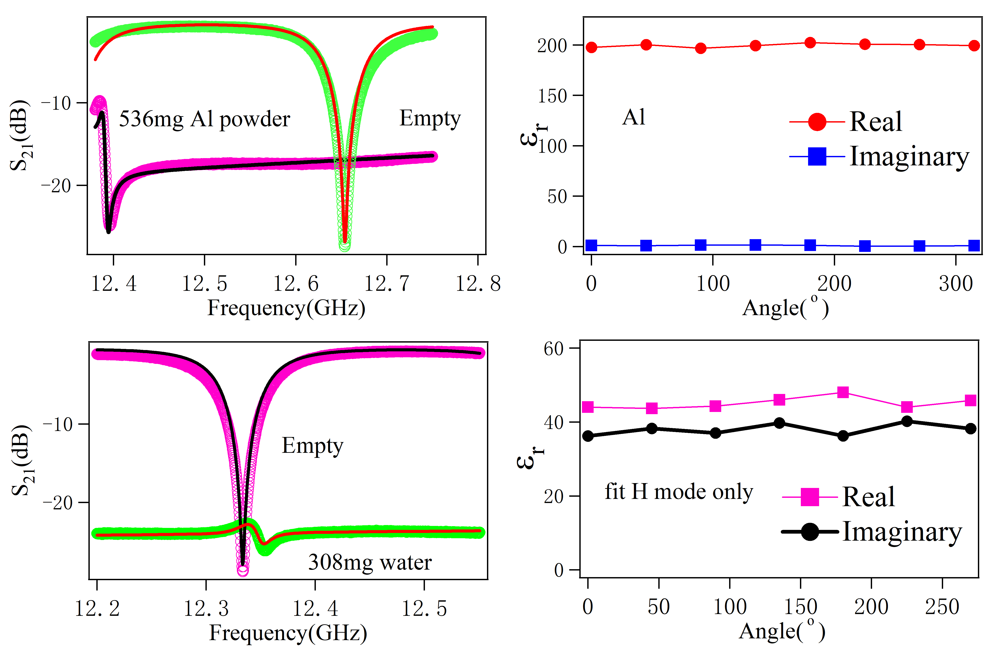
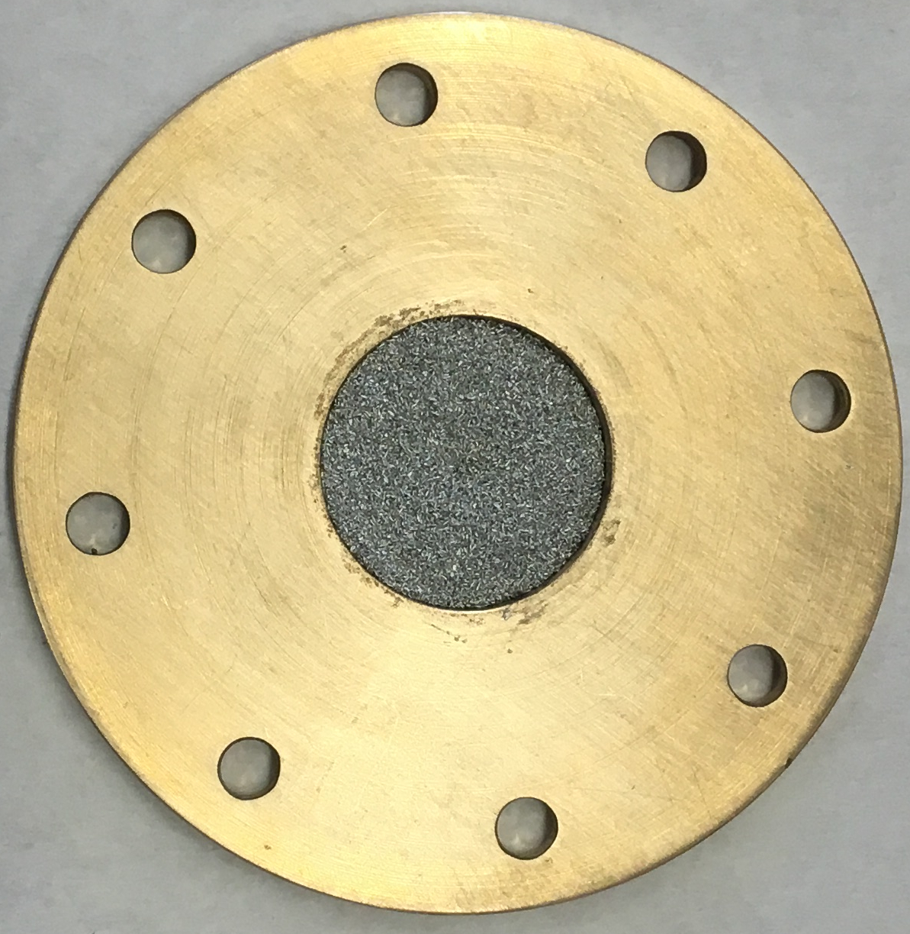
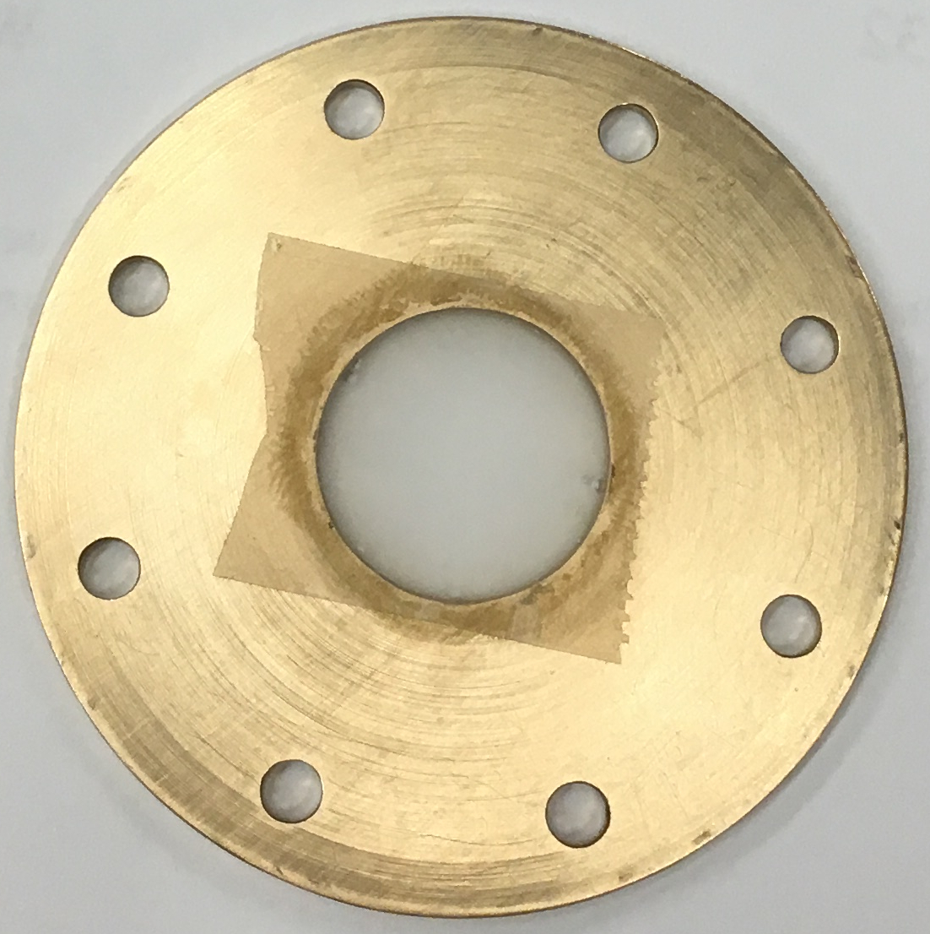
Aluminum powder and water
Al powder sample
Water sample

Slide 11
Compare with Yao’s previous work
 |  | Yao | This work
Teflon |  | 2.06 | 2.114
KNO3 | powder | 3.7
 | granule | 4 | 3.9106
NaNO3 | powder | 4.4
 | granule | 4.5 | 4.6045
NH4NO3 | powder | 5.1 | 5.3663
 | granule | 4.9
 |  | Recommended
Icing sugar |  | 1.5-2.2 | 1.8965

